Slide 1
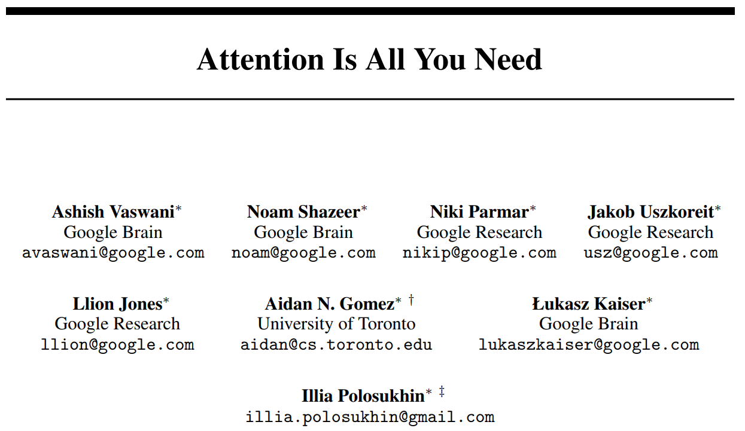
Jia Qi
018033910053
Notes:
I’ll introduce the Transformer first, in the hope of throwing out a minnow to catch a whale.

Slide 2
Content
Motivation
Model Architecture
Evaluation
Conclusion

Slide 3
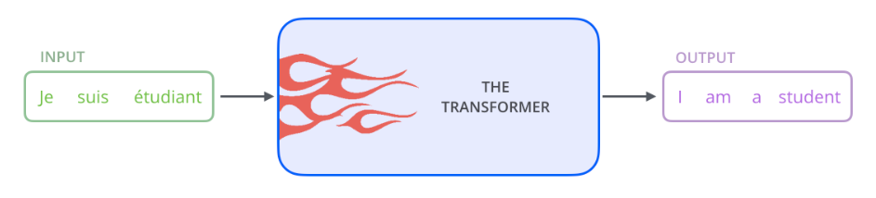
Motivation
RNN
Sequential
Preclude parallelization within training samples
CNN
Only capture local information with fewer convolution layers
Both:
Difficult to learn dependencies between distant positions
Attention
Directly compute between each pair of words
Notes:
Previously, the dominant sequence transection models are based on complex recurrent or convolutional neural networks.
Attention shows up.
That are the background and motivation for Transformer.

Slide 4
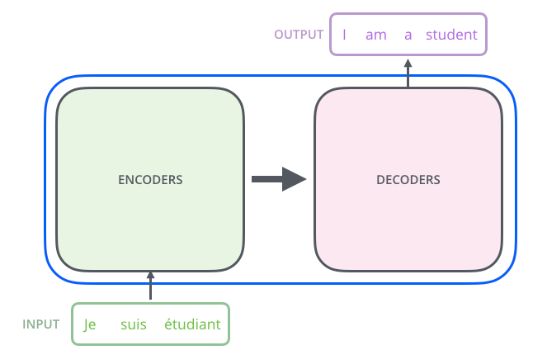
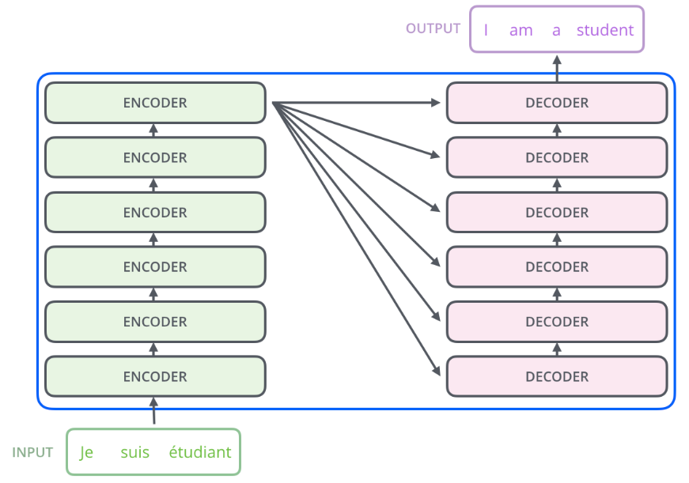
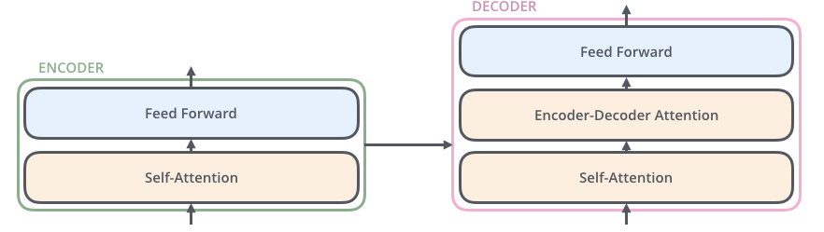
The Transformer
A High-Level Look
A Closer Look
A stack of six on top of each other.
Notes:
Take machine translation as an example, the input is a sentence in original language, and through the Transformer, we will get its translation as the output.
In this paper, both parts is a stack of encoders and decoders with the number of six. All of them are in the same structure while do not share weights.
As for encoder part, the inputs first flow through a self attention layer, then the output are fed to a feed forward neural network.
The decoder part also has both layers. Besides, there is an encoder-decoder attention, which helps the decoder focus on relevant parts of the processes input sentence offered by encoder.

Slide 5
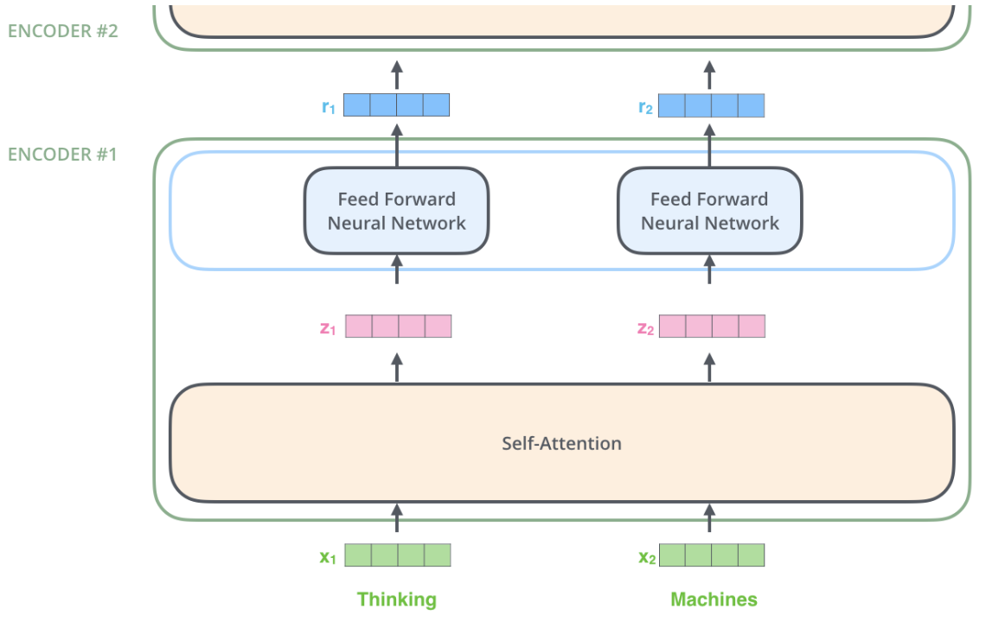
The Encoder
Outputs of Encoder#1
Pass through the same one individually
Upgraded embeddings
Communicate with each other
A list of words→embeddings
Notes:
First: change a list of words into embeddings by pre-trained word2vec models.
Then, what happens in self-attention layer?

Slide 6


Attention
Key1
Key2
Key3
Mapping a query and a set of key-value pairs to an output, where the query, keys, values, and output are all vectors.
The output is computed as a weighted sum of the values, where the weight assigned to each value is computed by a compatibility function of the query with the corresponding key.
Query
r(Q,K1)
r(Q,K2)
r(Q,K3)
S1
S2
S3
SoftMax()
a1
a2
a3
$$Attention\left(Q,K,V\right)$$
Attention Values
*
+
*
+
*
$$Self−Attention\left(X,X,X\right)$$
Value1
Value2
Value3
Notes:
Before self-attention, let me remind u of the basic attention mechanism.
Self-attention: Q\K\V are the same or come from the same sequence

Slide 7
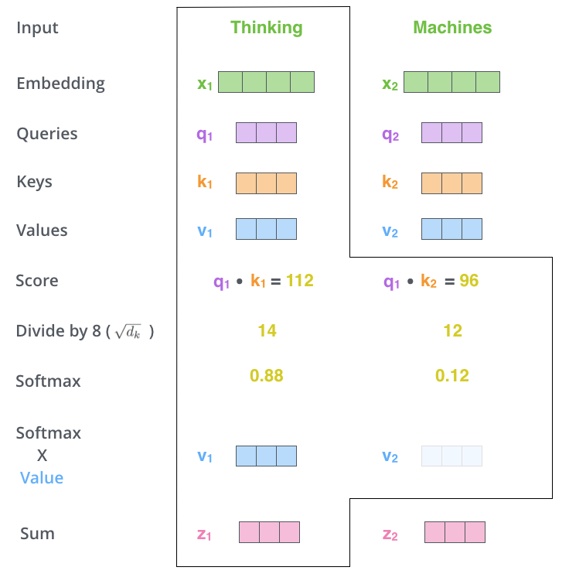
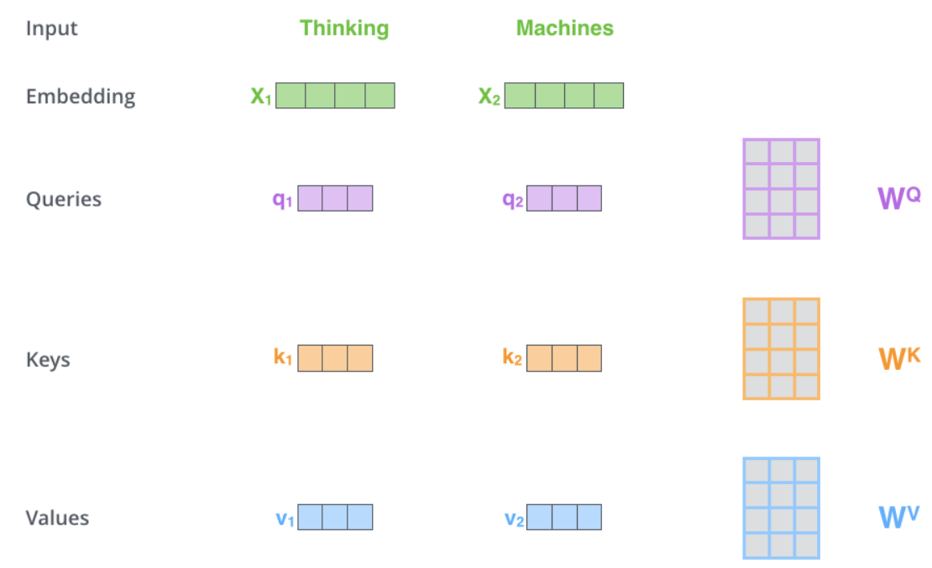
Self-Attention
Step1：Create queries, keys and values from
each of the input embeddings.
Notes:
Assume the input sequence is “thinking machines”
Multiplying x1 by the WQ weight matrix produces q1, the "query" vector associated with that word. We end up creating a "query", a "key", and a "value" projection of each word in the input sentence.

Slide 8
Self-Attention
Step1：Create queries, keys and values from
each of the input embeddings.
Step2：Calculate a score.
Step3：Devide the scores by the square root
of the dimension of the key vectors. WHY?
Step4：A SoftMax Operation
Step5：Multiply each value vector by the
softmax score.
Step6：Sum up the weighted value vectors.
Notes:
It is said that this will lead to more stable gradients
Softmax normalizes the scores so they’re all positive and add up to 1.
The intuition here is to keep intact the values of the word(s) we want to focus on, and drown-out irrelevant words
Finally, we get the output of the self-attention layer for “thinking”.
Findings:
The number of the input embeddings is the same as the number of the output attention values.
By attention mechanism, we can shorten the path length between long-range dependencies to 1. It is also proved that self-attention can greatly capture the dependencies within a sequence.
What is most important: we can calculate the attention values for each word in a sequence at the same time. We don’t have time steps anymore.

Slide 9
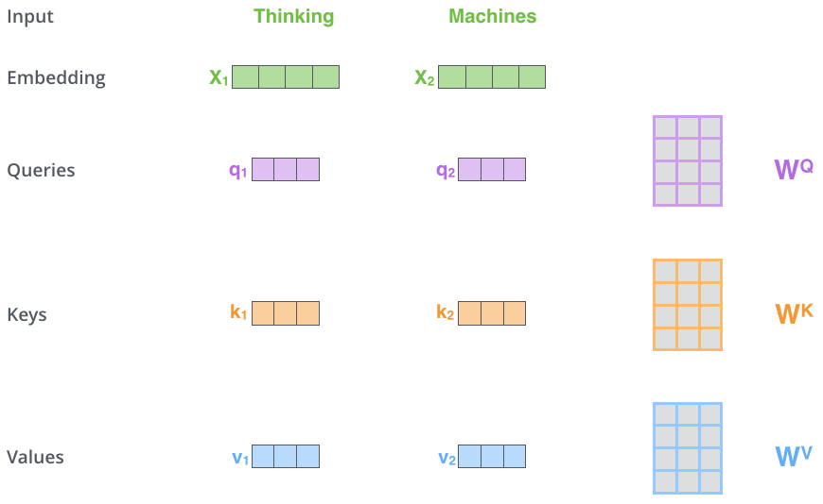
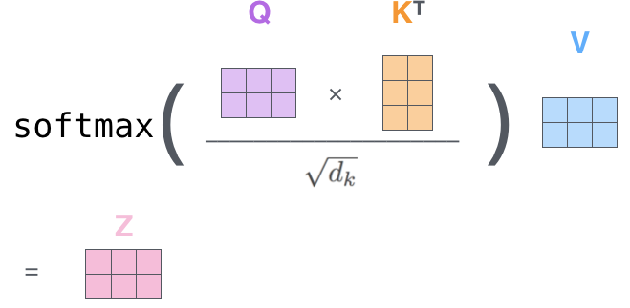
Matrix Calculation of Self-Attention
Step1：Create queries, keys and values from
each of the input embeddings.
Notes:
Then, we represent the above steps in this equation. Get the output matrix Z of a self-attention.
Do u understand the self-attention now? Then let’s move on to see what is multi-head attention?

Slide 10
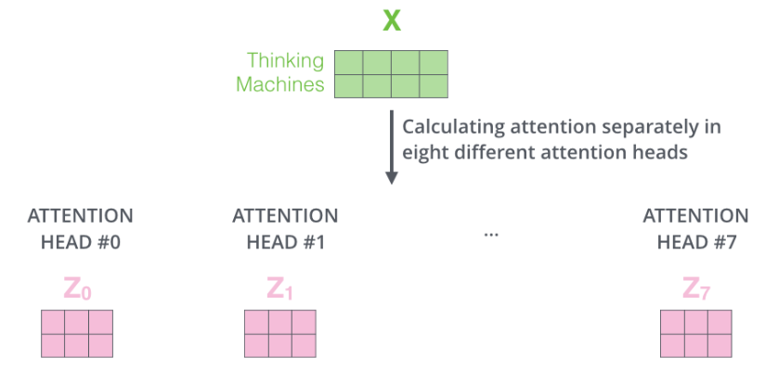
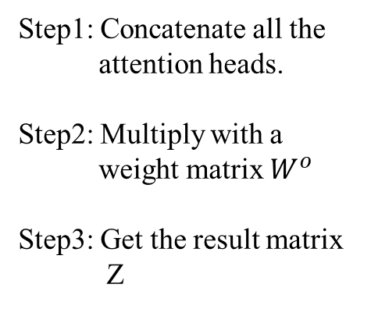
Multi-Head Attention
Use a number of attentions at the same time without sharing the parameters.
Able to jointly attend to information from different representation subspaces at different positions.
Step1: Concatenate all the
attention heads.
Step2: Multiply with a
weight matrix $W^{o}$
Step3: Get the result matrix
Z
Notes:
Emm I’m not quite agree with this confused name. It makes multi-head attention sounds quite mysterious and difficult to understand. In fact, it is very simple.

Slide 11
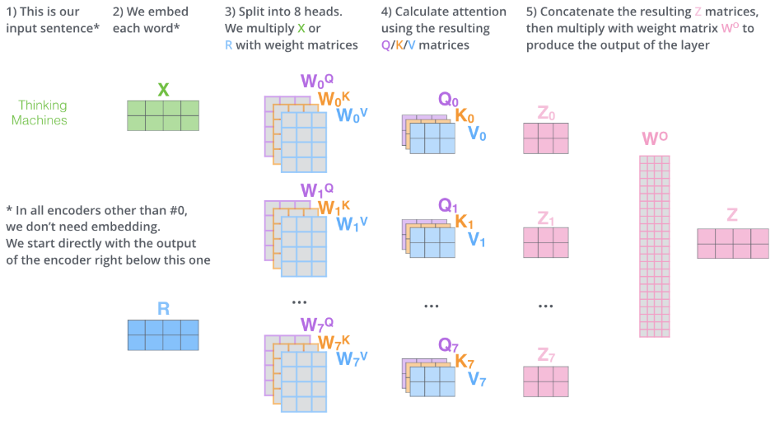
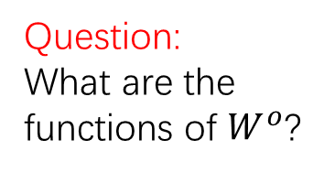
Multi-Head Attention
Question:
What are the functions of $W^{o}$?
Answer:
Transform the size of the matrix.
Gather the useful information from all of the attention heads
Notes:
There is no dependencies between these eight heads, so we can train them at the same time.

Slide 12
So far, what information does the model miss?
The order of the words in the sequence!!!
If we disorder the words in the sequence, it won’t effect the result of the attention mechanism.

Slide 13
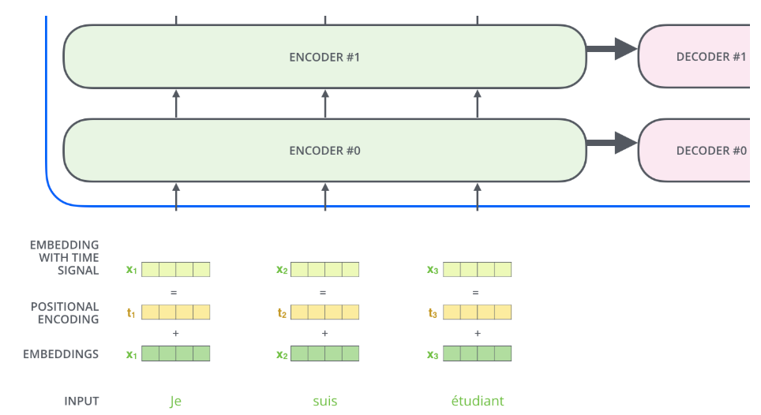


Positional Encoding
$$PE\left(pos,2i\right)=sin⁡(pos/{10000}^{2i/512})$$
$$PE\left(pos,2i+1\right)=cos⁡(pos/{10000}^{2i/512})$$
Question: How does it reflect the relative and absolute positions?
Notes:
To deal with this, the transformer adds vector to inject some information about the relative or absolute positions.
The values of positional encodings follow a specific pattern.
With sin version, it allows the model to extrapolate to sequence lengths longer than the ones encountered during training.

Slide 14
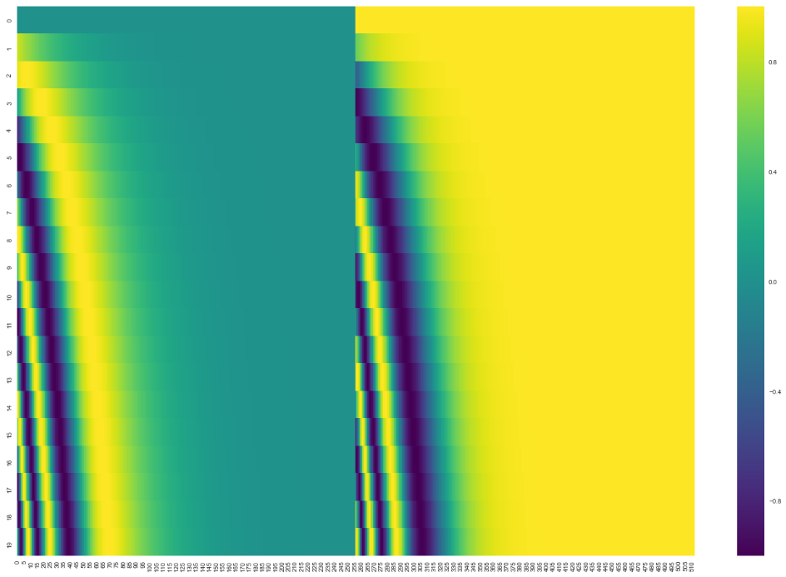
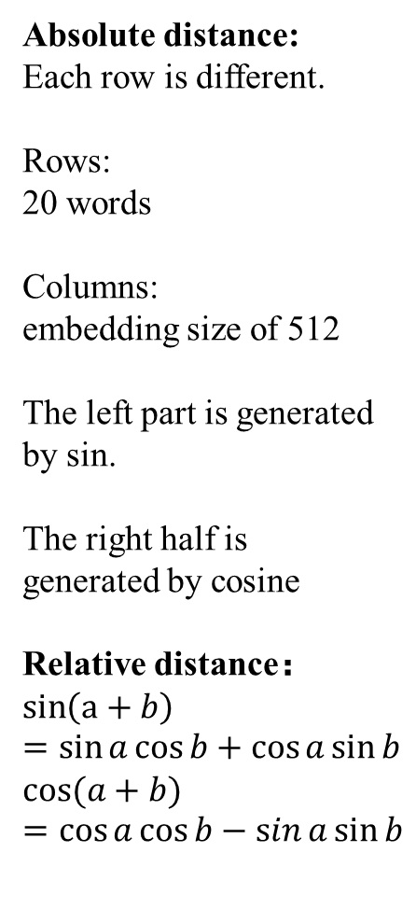
Absolute distance:
Each row is different.
Rows:
20 words
Columns:
embedding size of 512
The left part is generated by sin.
The right half is generated by cosine
Relative distance：
$$\sin\left(a+b\right)=\sin{a}\cos{b+\cos{a\sin{b}}}$$
$$cos⁡(a+b)=\cos{a}\cos{b−\sin{a\sin{b}}}$$
Notes:
An example of positional encoding for 20 words
They are concatenate to form each of the positional encoding vectors

Slide 15
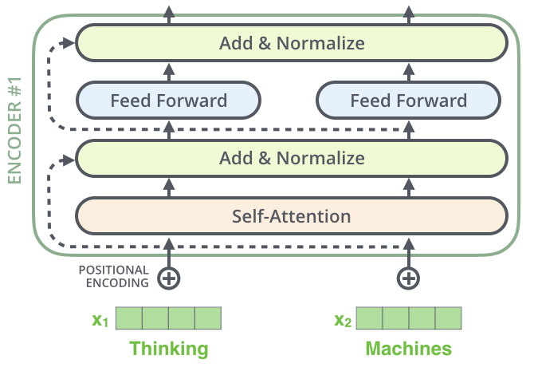
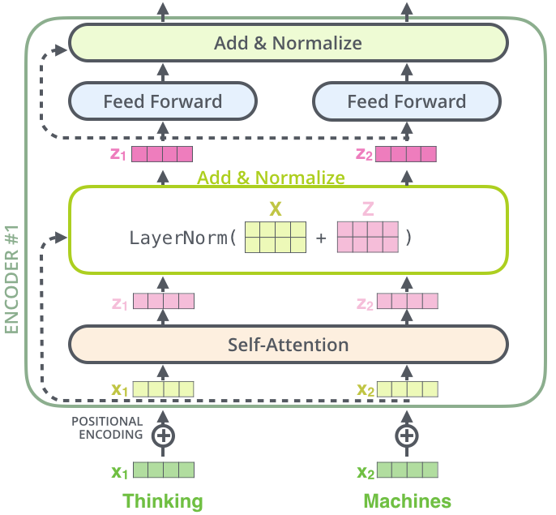
Residual Connection and Layer Normalization
Notes:
Each self-attention sub-layer has a residual connection around it , and is followed by a layer-normalization step.

Slide 16
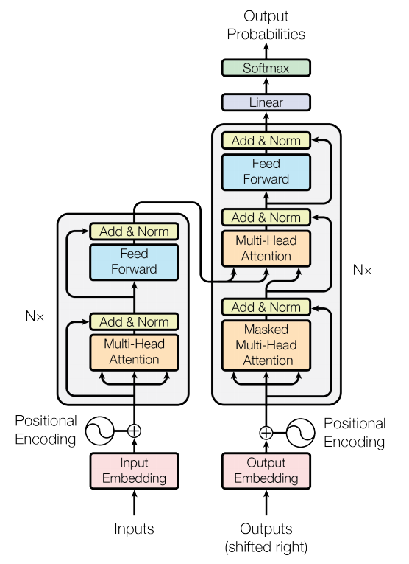
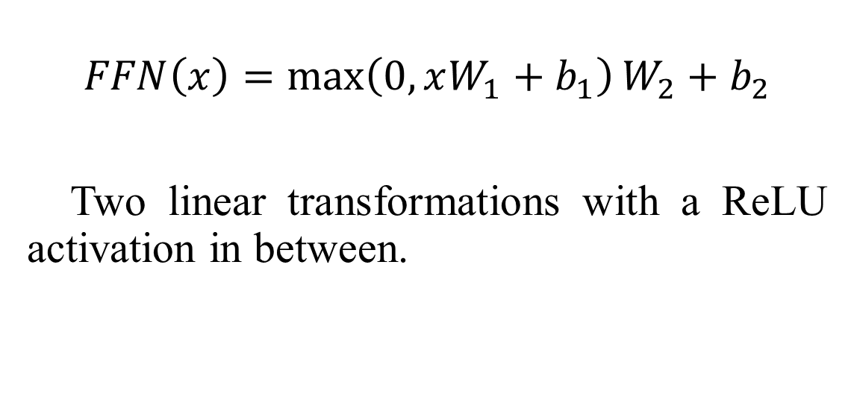
Position-wise Feed-Forward Networks
$$FFN\left(x\right)=\max\left(0,xW_{1}+b_{1}\right)W_{2}+b_{2}$$
Two linear transformations with a ReLU activation in between.
Notes:
So far, we have talked about most components in this figure except encoder-decoder multi-head attention part in the decoder and the final output.

Slide 17
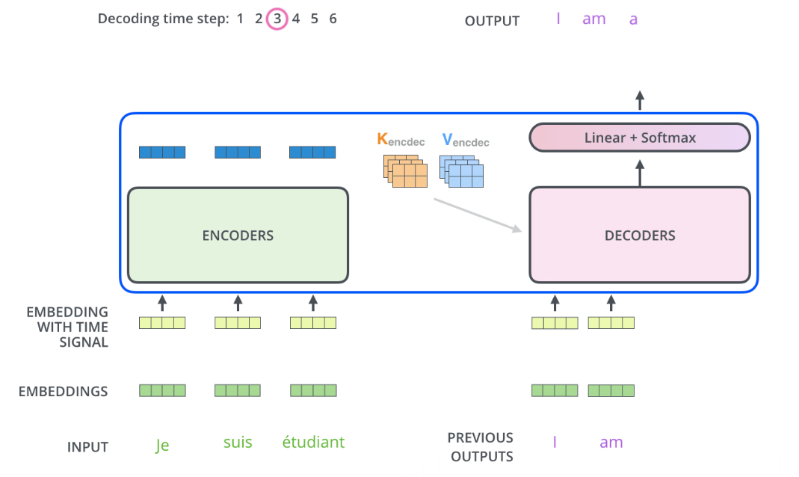
Decoder—Encoder-Decoder Attention
Help the decoder focus on appropriate places in the input sequence.
Notes:
It also has the same structure as we have talked before. The different is that it’s not self-attention.
The keys, values, and queries do not have the same origin.
The output of the top encoder is transformed into a set of attention vectors Keys and Values. The Queries are come from the self-attention in the decoder part according to previous outputs.

Slide 18
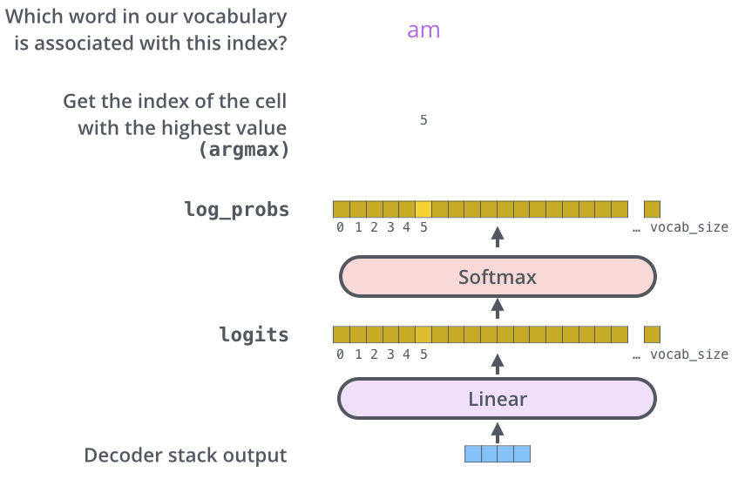
Decoder
Notes:
Turn the decoder stack output into a word

Slide 19
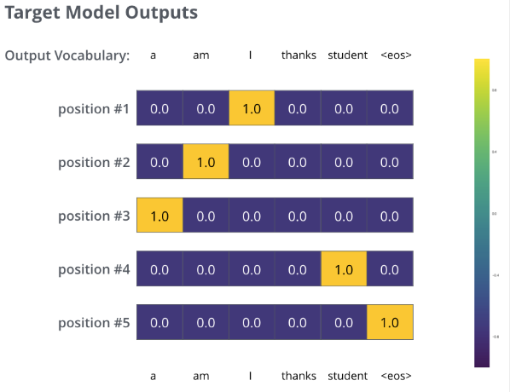
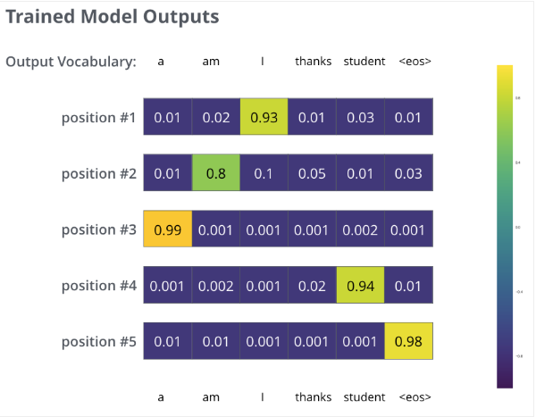
Loss Function
Greedy decoding or beam search
Notes:
The loss is calculated between target model outputs and trained model outputs of the whole sentence with greedy decoding or beam search.

Slide 20
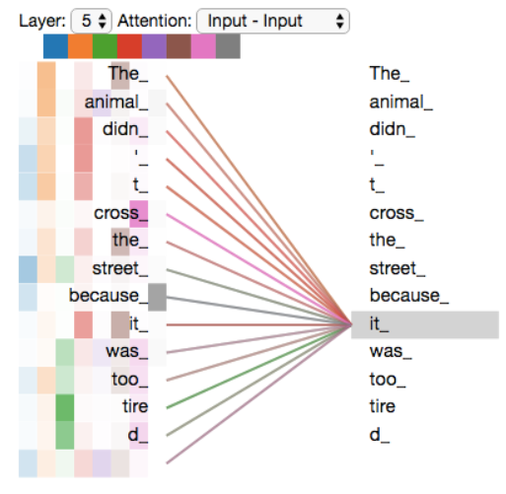
Evaluation
Notes:
Here is a picture of the attention weight of different head.
Each column represents the result of an attention head
As we encode the word "it", one attention head(column 2)is focusing most on "the animal", while another(column 3) is focusing on "tired" -- in a sense, the model's representation of the word "it" bakes in some of the representation of both "animal" and "tired".
With multi-heads, we can find out different kinds of dependencies within a sequence.

Slide 21
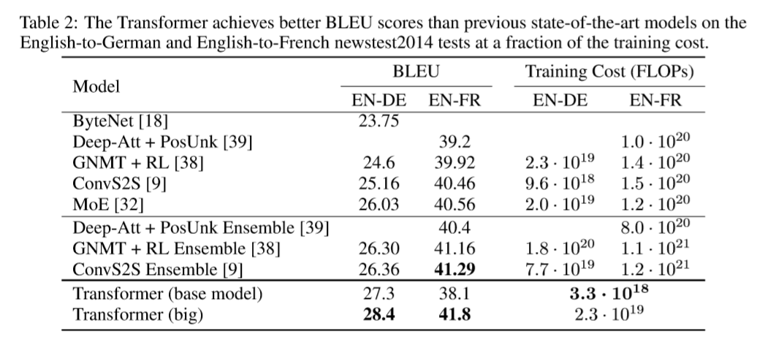
Evaluation
Notes:
The model performance on translation tasts.

Slide 22
Conclusion
The first sequence transduction model based entirely on attention and the results show that the model works.
Achieve parallelization which speed up the training process.
Show that the multi-head attention can jointly attend to information from different representation subspaces at different positions.
Can’t use the positional information inherently.

Slide 23
Thank you~

Slide 24
Q&A

